Slide 1


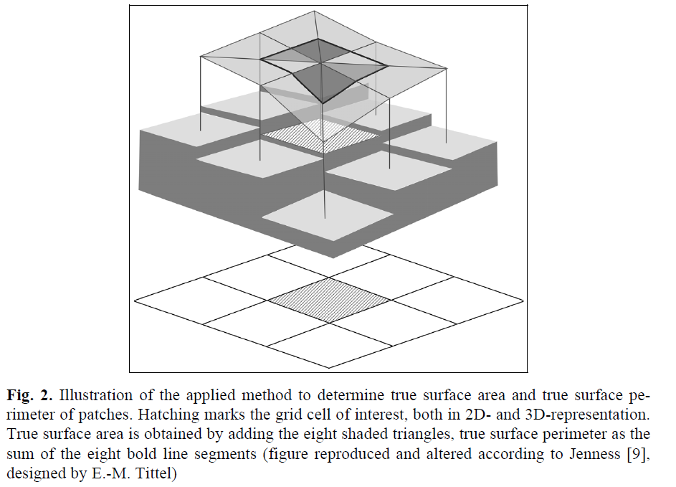
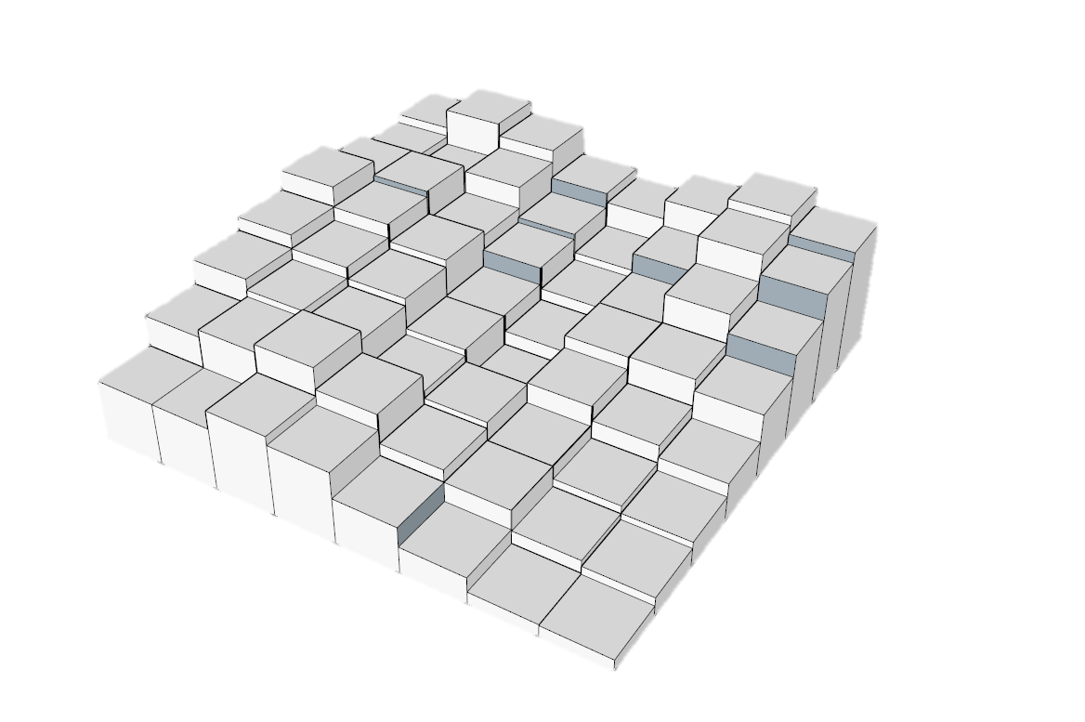
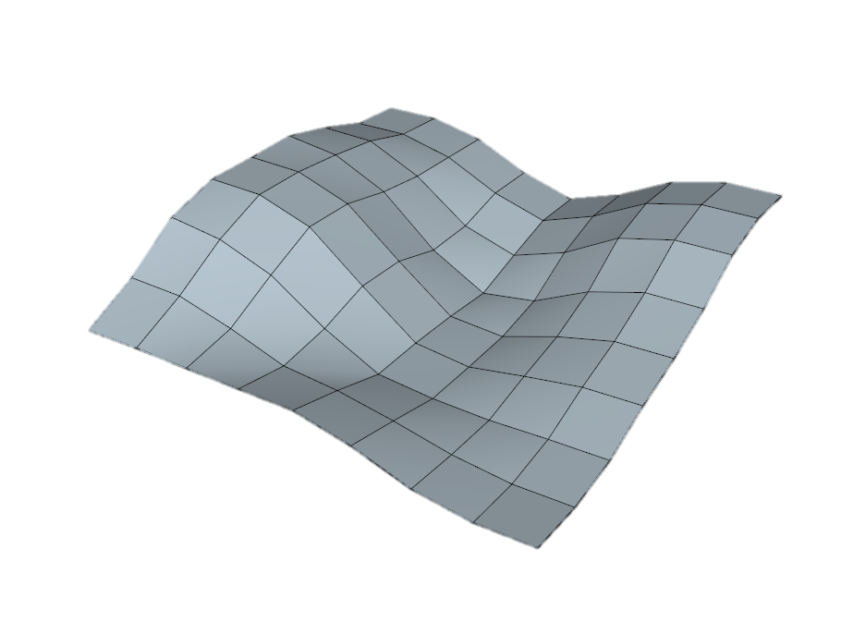
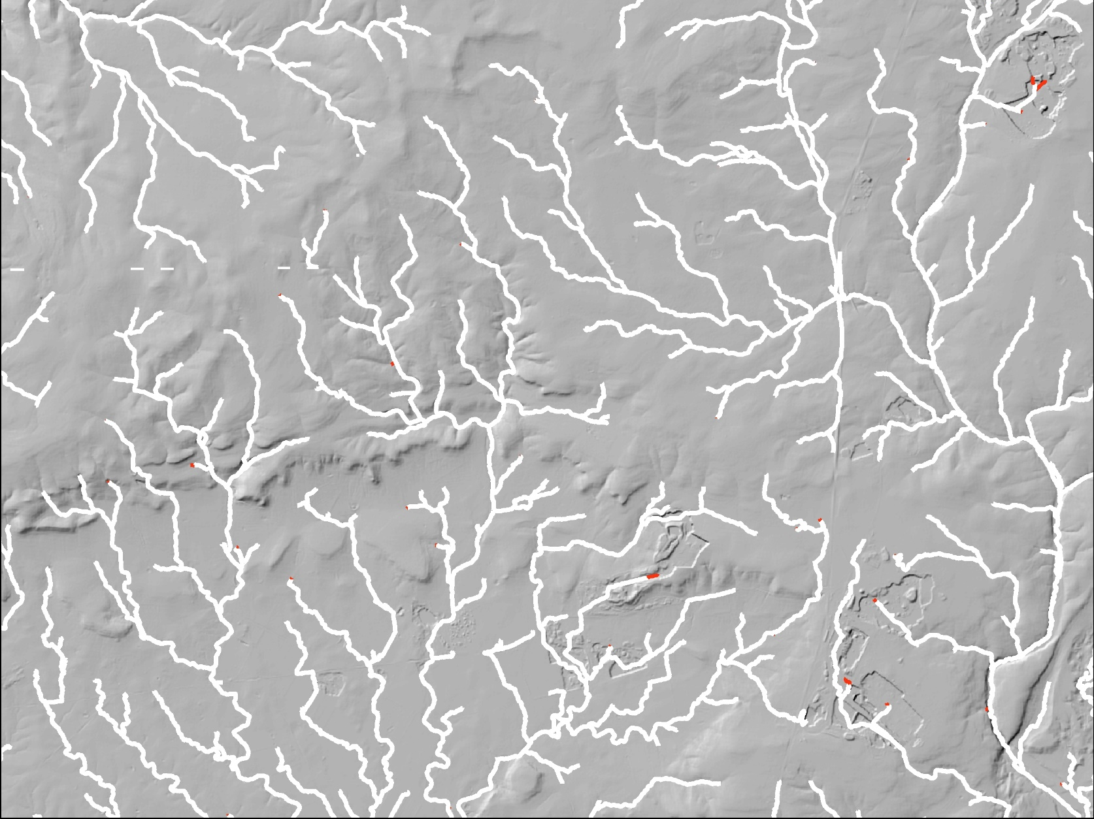
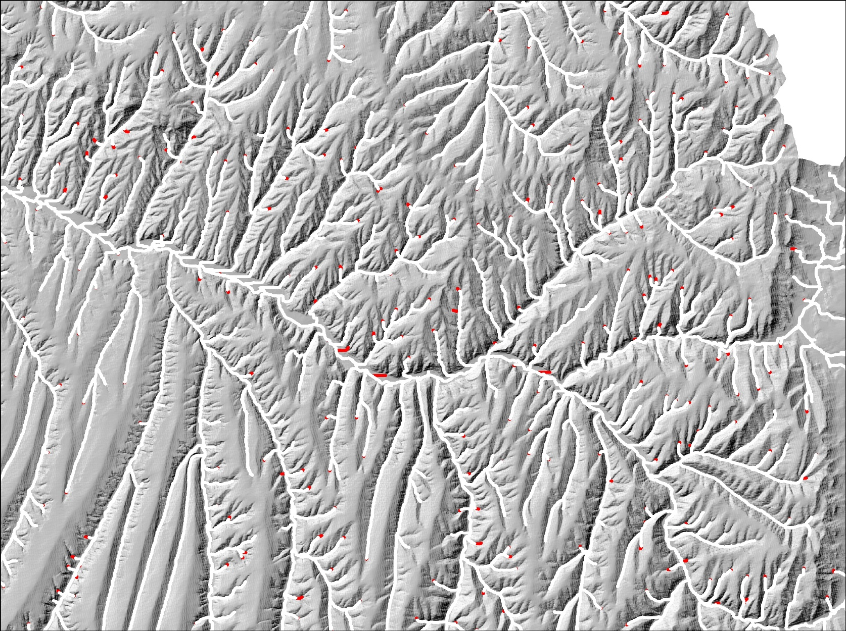
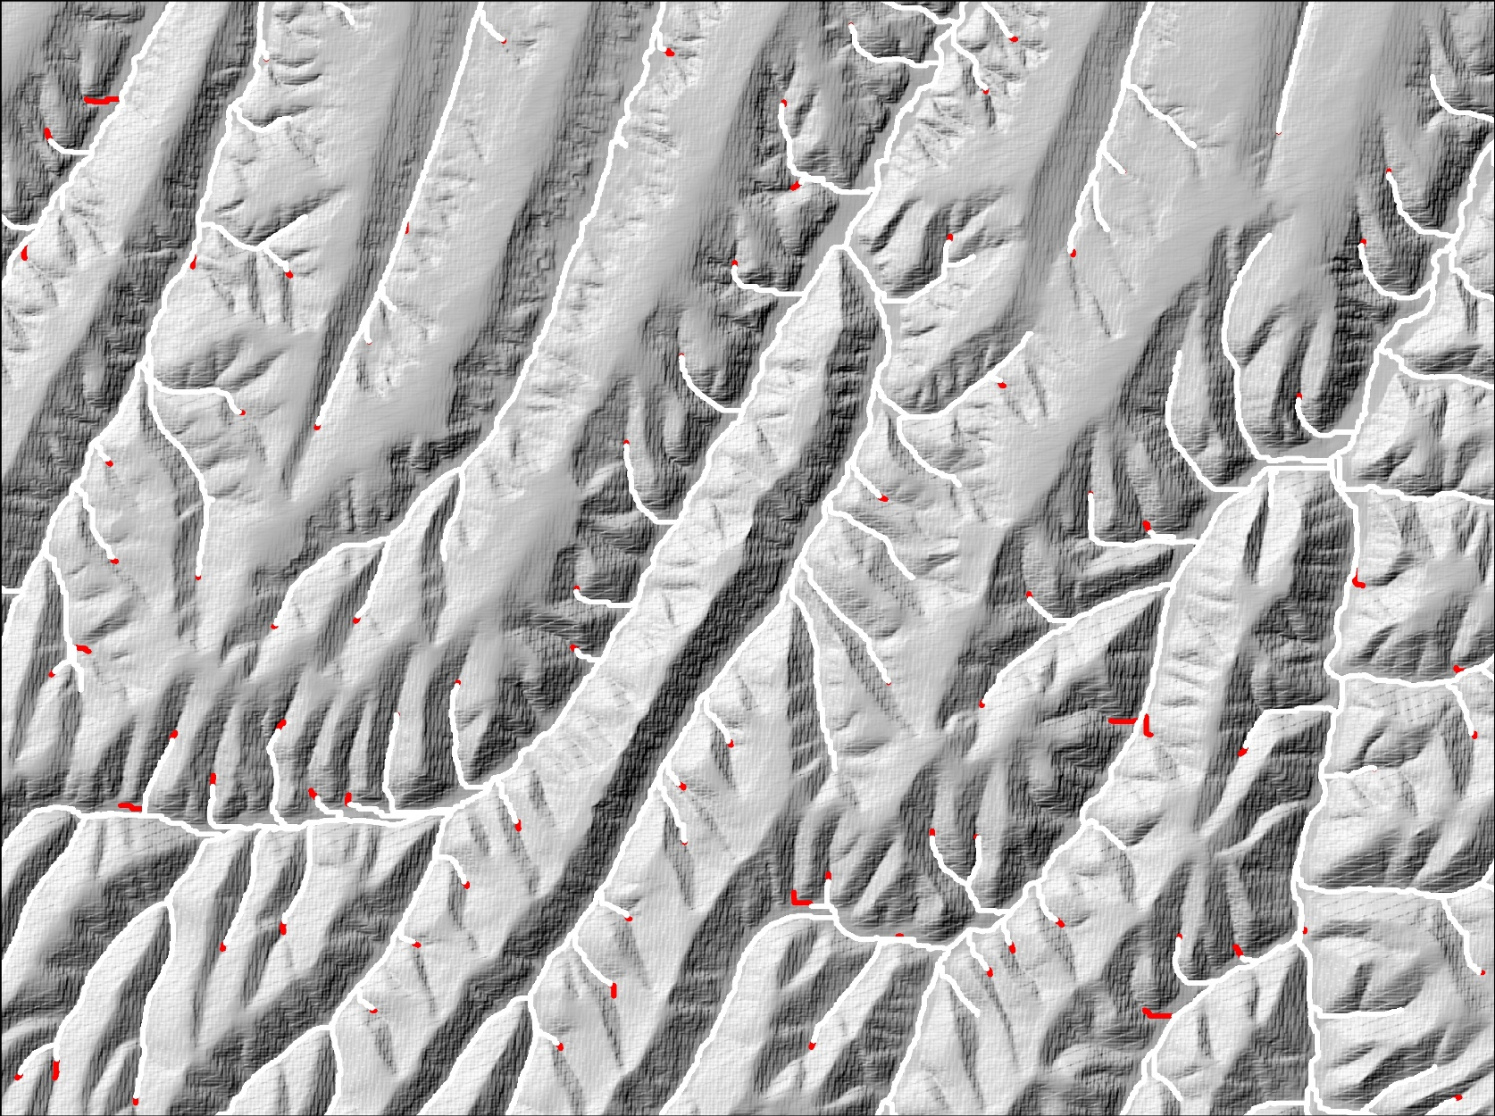
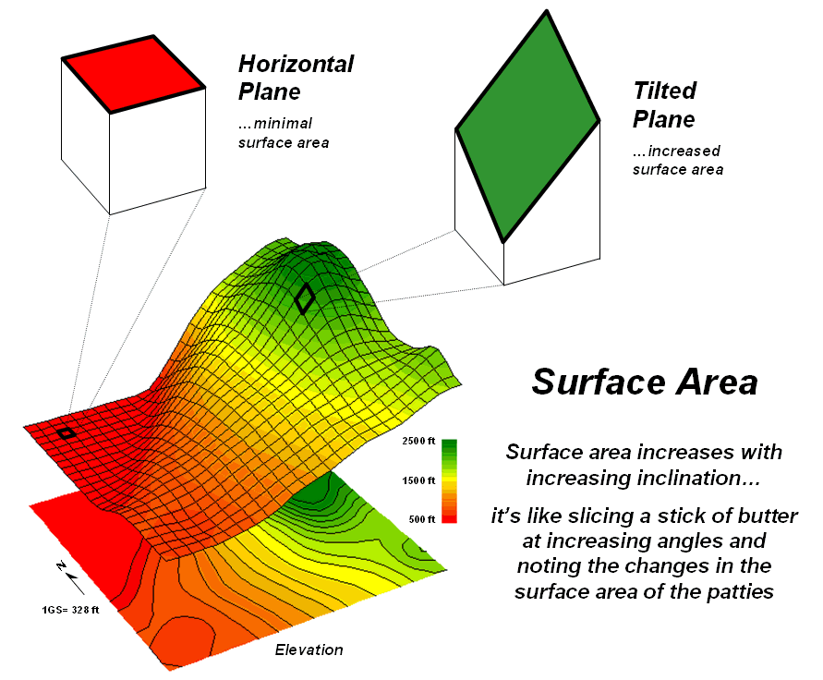
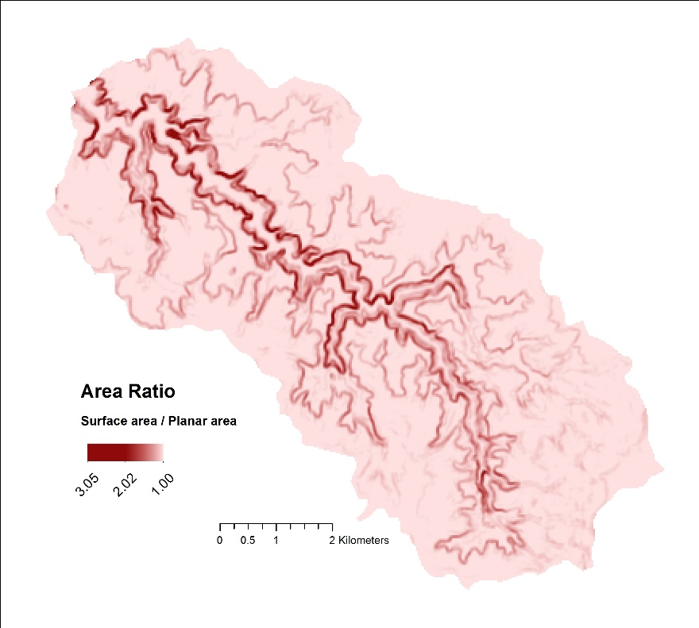
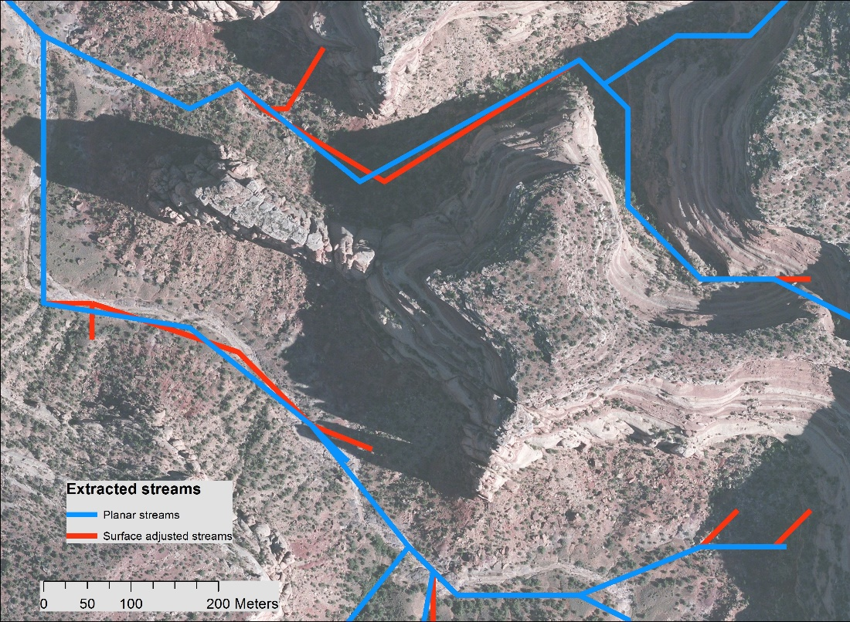
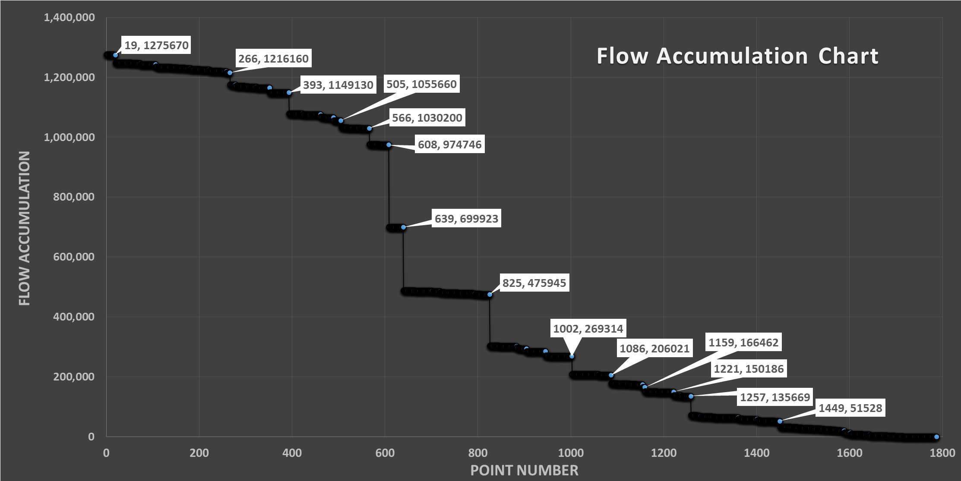
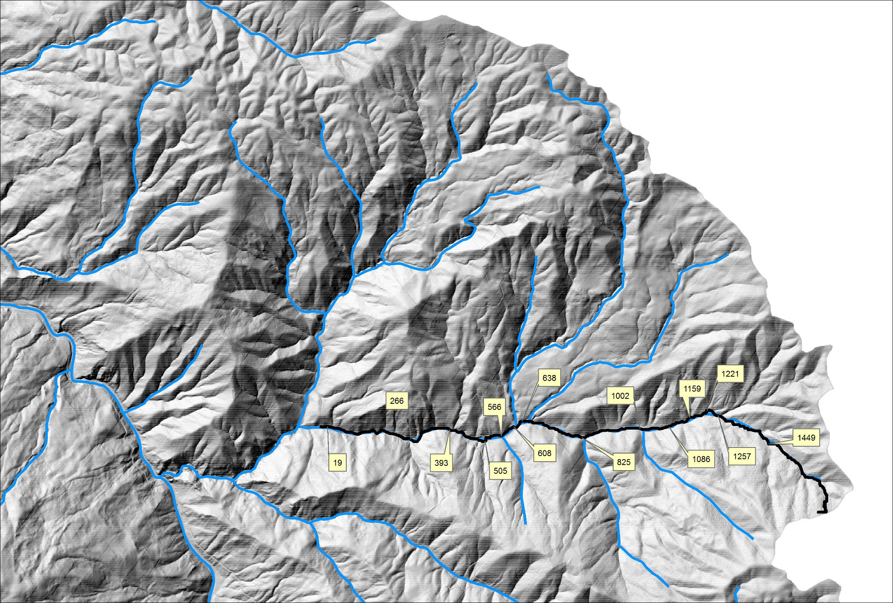
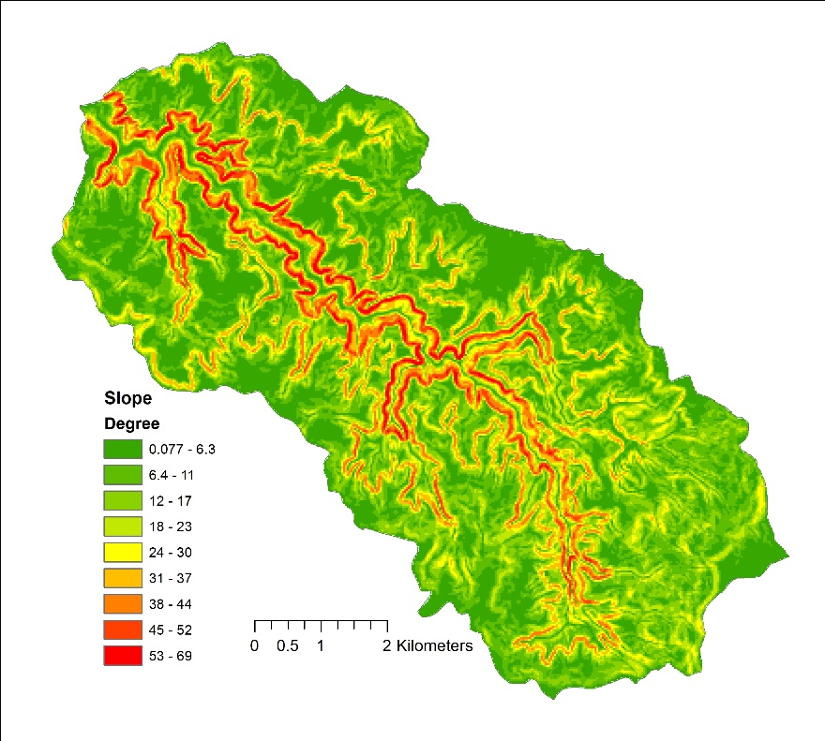
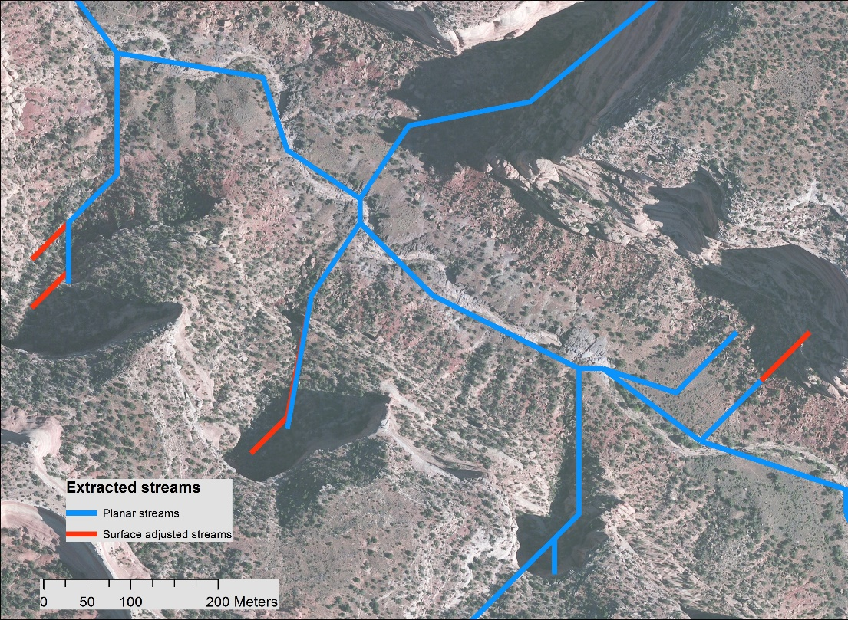

Hydrologic Flow Accumulation Modeling Using Surface Area
Mehran Ghandehari, Barbara P. Buttenfield
Meridian Lab, Department of Geography, University of Colorado-Boulder
Abstract
Surface Area Calculation
Conclusion
The terrain surface plays a critical role in modeling geomorphic, hydrologic, atmospheric, and ecological processes. Understanding the terrain surface can guide realistic characterization of these processes. Projection of terrain features into a planar surface leads to some distortion in the geometry of terrain elements. Generally, for a Digital Elevation Model (DEM), distance, perimeter and area are underestimated in comparison to actual measurements, due to within pixel variations in slope and curvature. This matter is ignored in most terrain-based GIS analysis. This research employs realistic surface geometries of terrain for a more accurate and precise mapping of streams from DEMs. The flow accumulation model, which employs planar area to delineate the upstream drainage area of each pixel, is the predominant approach for extracting streams from DEM. One key weakness of this approach is that the two-dimensional method used for calculating area does not account for the slope and curvature of the terrain and precious information is lost. This research presents one possible strategy for the incorporation of surface area into a flow accumulation matrix. This approach substitutes calculation of upstream surface area instead of planar area.
The surface area of each pixel is calculated using a triangulation moving window algorithm. In each pixel all of the 3d triangles between the pixel and adjacent pixels are constructed. The length of triangle edges are calculated based on the Pythagorean Theorem, and then the area of each triangle is computed. Finally, the surface area of the center pixel is equal to sum of the area of all triangles (Jenness, 2004).
Terrain is currently modeled in a grid of pixels, assuming that elevation values are constant within any single pixel of a Digital Elevation Model (DEM) (‘rigid pixel’ paradigm). The assumption of rigid pixels generates basic spatial measurements that are in fact imprecise. In truth, terrain can bend, twist and undulate within each pixel, more similar to a continuous and flexible fabric. In this research the flow accumulation is adjusted based on the surface area, and the results illustrate that amount of imprecision depends on the terrain type and DEM resolution. The imprecision can be ignored for flat terrains and/or fine resolution DEMs. But, surface adjustment becomes more important at coarser resolutions or rugged or rough terrains.
Results
Case Study 1
These Figures show the difference between the extracted streams from the planar flow accumulation and the surface adjusted flow accumulation in different terrain types (10 meters DEM is used here). The streams extracted form the surface adjusted flow accumulation are always longer (the increments are illustrated by red color in the following figures). The experiments also show that surface area is larger than planar area, and as a result streams extend a little bit (.03% and 2.2% length increase in the HUC10 # 1209020104 and HUC8 # 14050006, respectively).
Texas HUC10 # 1209020104
Colorado HUC8 # 14050006
Colorado HUC8 # 14050006
Future Work
We will examine the effects of surface adjusted terrain on extracted streams under varying topographic conditions (flat vs. steep slopes, smooth and vs. rough terrain), precipitation regimes (humid, dry, transitional) and landuse (developed, cultivated, natural) found across 10-15 study areas in the U.S., where DEMs at a range of resolutions and LiDAR data are available.
The plan curvature influences convergence and divergence of flow and the profile curvature affects the acceleration and deceleration of flow. Analyzing the curvature of pixels in a catchment and its relation to the streams is considered as the next step of this research. For example, our preliminary results show that the mean and sum of curvature in a catchment can be used to identify missing channels and headwaters.
Case Study 2
I this case study, we calculated the ratio of surface area to planar area, as illustrated in Figure a. The subbasin is located at the Black Ridge Canyons in Colorado (HUC12 code is 140100051902). 30 meters DEM was used in this case study. Canyon is a steep natural feature, and as you can see in Figure a and b, the area ratio and slope is high. In Figure c and d, the red and blue lines are the streams extracted from the surface adjusted flow accumulation and the planar flow accumulation, respectively. Here the total length of streams in the planar case is 195 kilometers and the length of surface adjusted streams has increased by 763 meters. In this case study, the surface area raster was used as a weight in the flow accumulation tool of ArcGIS software. It can be seen that the extracted streams from two methods do not match on the common places. This is a problem in the flow accumulation tool of ArcGIS that we noticed. Then the TauDEM tool, which has been developed by David Tarboton (http://hydrology.usu.edu/taudem/taudem5/index.html) was used, and this problem was solved.
Case Study 3
In this case study, a flow accumulation chart was created. 3 meters DEM, and planar flow accumulation area were used in this case study. The x axis is point numbers and y axis is the flow accumulation values for the corresponding points. In this study, an arbitrary point on a main channel was selected and it was traced uphill to the ridge (The black points highlighted in the figure). Then, the flow accumulation value of the points was extracted from the flow accumulation matrix. The points where the flow accumulation changes considerably are identified in the figure and chart (one of them is identified by an arrow for example). These points are meaningful and can be used to identify missing streams in the available datasets. Here, the NHD dataset is used, and it has been proved that a lot of first order tributaries are missing in this dataset.
References
(a)
(c)
Jenness, J. S. (2004). Calculating landscape surface area from digital elevation models. Wildlife Society Bulletin, 32(3), 829-839.
Stanislawski, L. V., Buttenfield, B. P., & Doumbouya, A. (2015). A rapid approach for automated comparison of independently derived stream networks. Cartography and Geographic Information Science, 42(5), 435-448.
Acknowledgments
(b)
(d)
We would like to acknowledge Lawrence V Stanislawski, researcher of Center of Excellence for Geospatial Information Science at U.S. Geological Survey, for providing us with the data.
Figure form: Berry, J. K. (2007). Map analysis: understanding spatial patterns and relationships. GeoTec Media.
California HUC12 # 170500040404
GIS in the Rockies Conference, September 21-22, 2016

